Slide 1
Neural radiance fields for dummies (myself included)
WtF are NeRFs ?

Slide 2

Introduction: use-case of vanilla NeRF

Slide 3
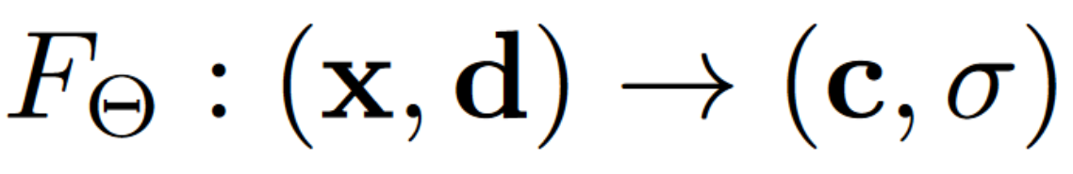
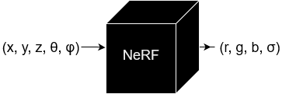
Introduction: Inputs and outputs

Slide 4
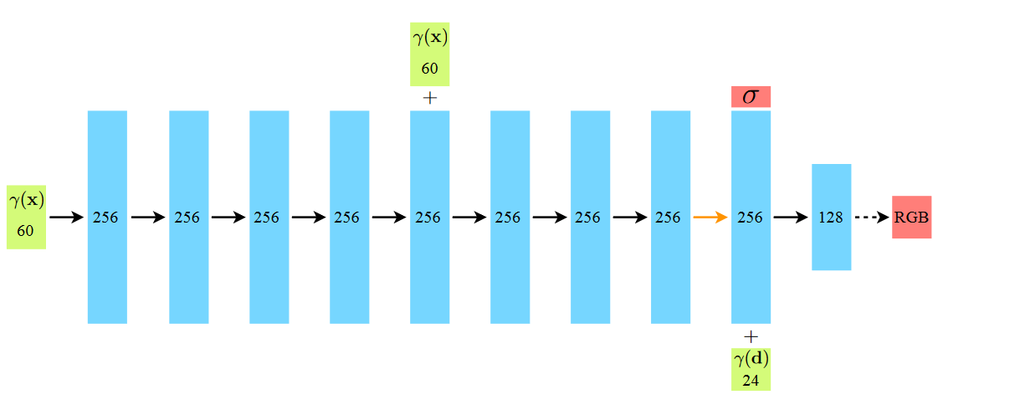
Architecture
Nema aktivacije
sigmoida
We encourage the representation to be multiview consistent by restricting the network to predict the volume density σ as a function of only the location x, while allowing the RGB color c to be predicted as a function of both location and viewing direction.

Slide 5
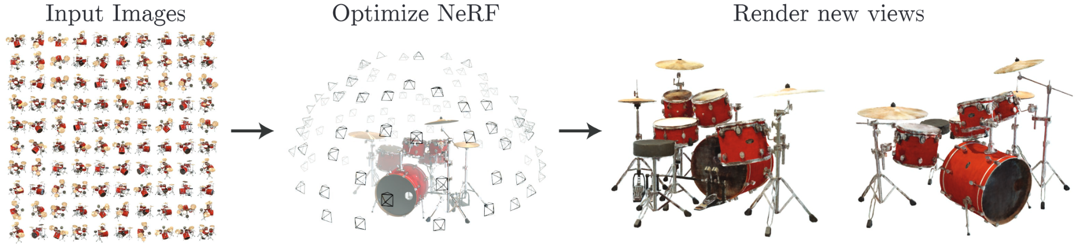
What kind of data do you need?
Later models are more robust to “bad” data
COLMAP for real world data
* no views from under the scene - hemisphere
Mildenhall, Srinivasan, Tancik et al. - ECCV20

Slide 6
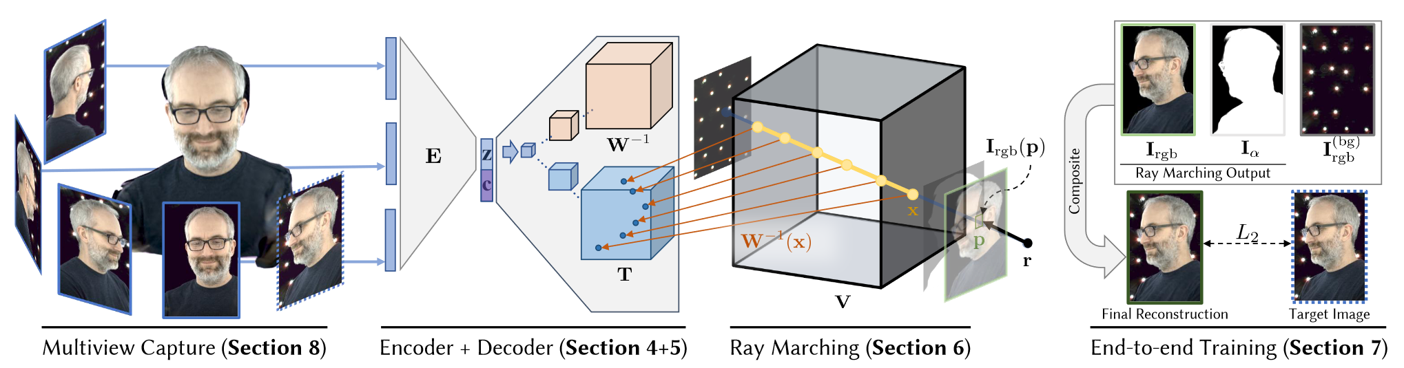
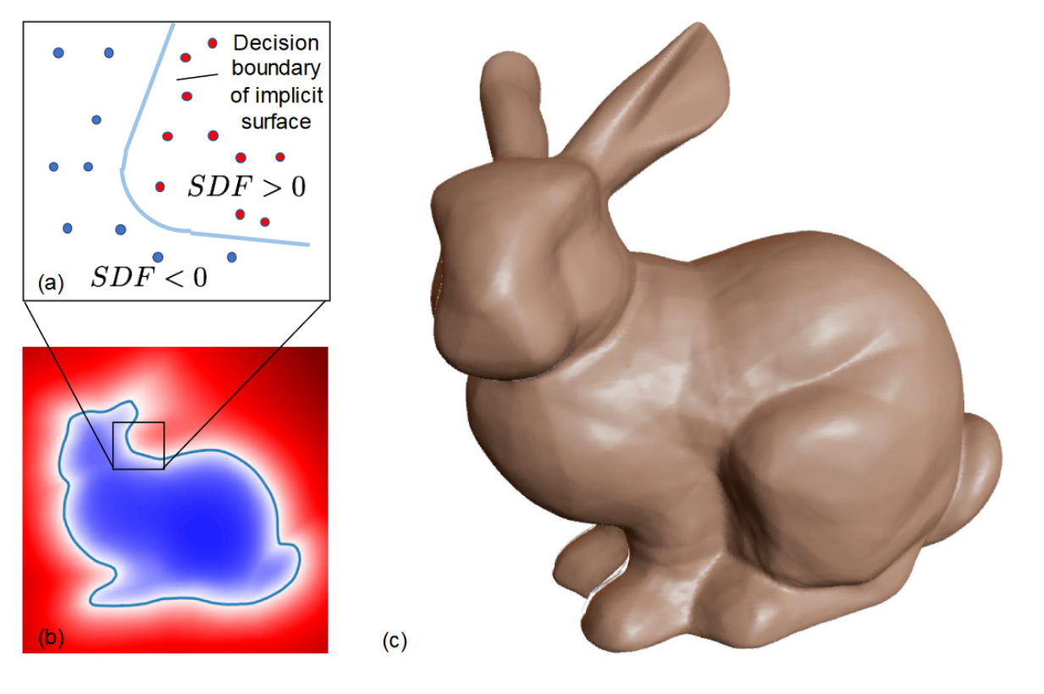
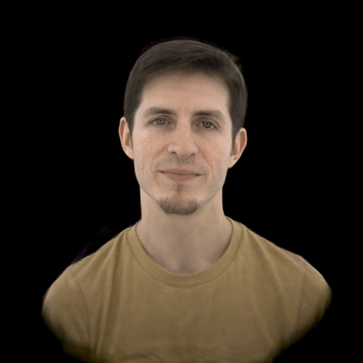
Short comments on related work
Neural Volumes
RGB+alpha volume rendering
pro: looks good con: (storage requirements)
10 days on a single nvidia v100
Deep SDF
NNs for continuous shape representation
pro: smaller + faster than <- con: weird math
Lombardi et al. - ACM_TOG 19
Park et al. - CVPR19

Slide 7
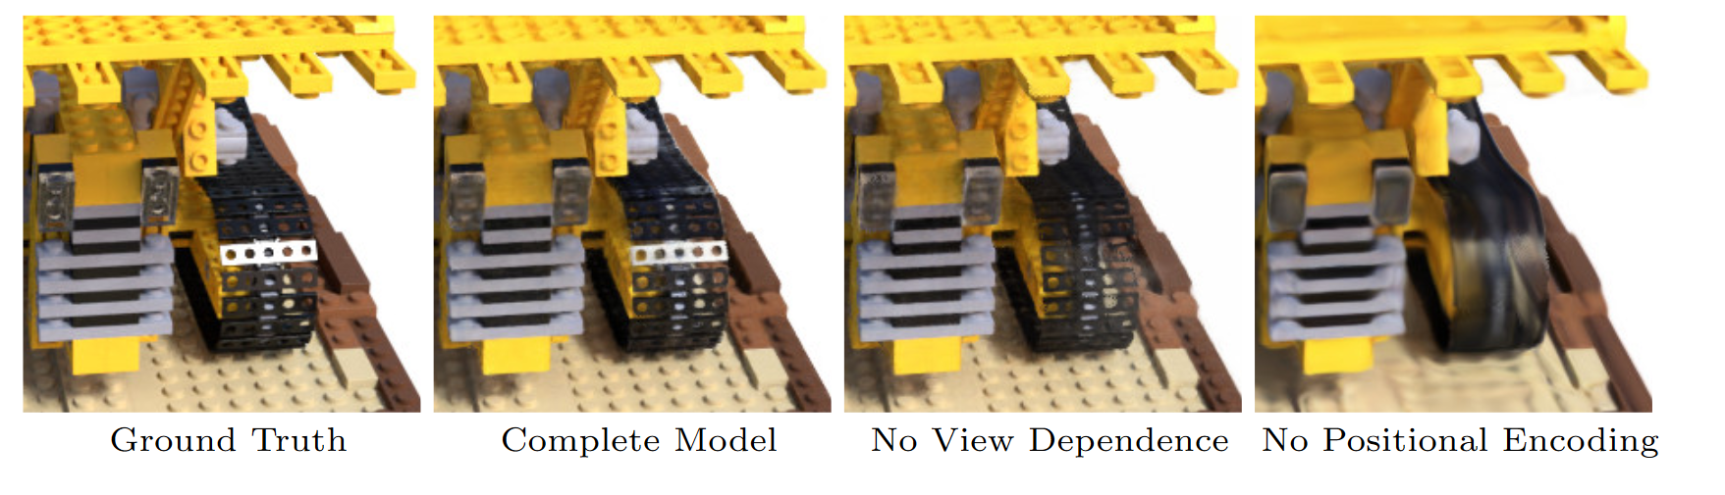
5.1 Positional encoding
Positional encoding helps the network learn high-frequency “signals”
Vaswani, Shazeer, Parmar, Uszkoreit, Jones, Gomez, Kaiser, Polosukhin - NIPS17
Hornik, Stinchcombe, White - NN89

Slide 8
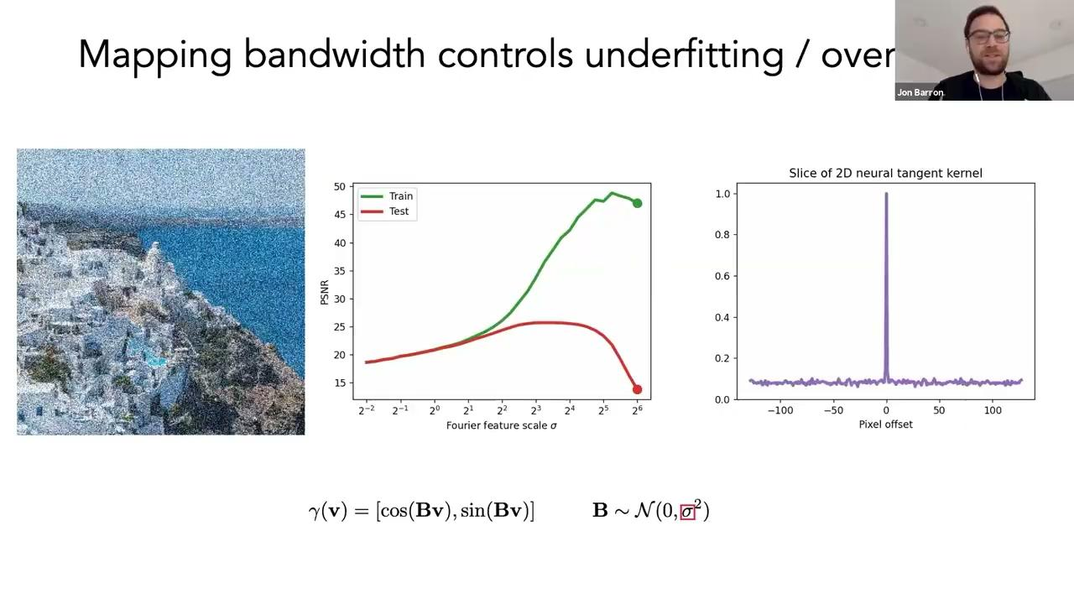
Tancik, Srinivasan, Mildenhall - NIPS20

Slide 9
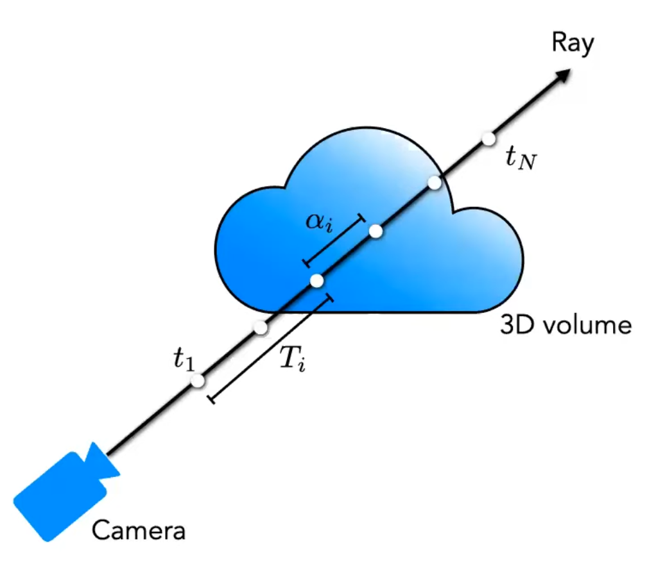
Volume rendering
Probability of empty space
Kajiya, Herzen - SIGGRAPH84

Slide 10
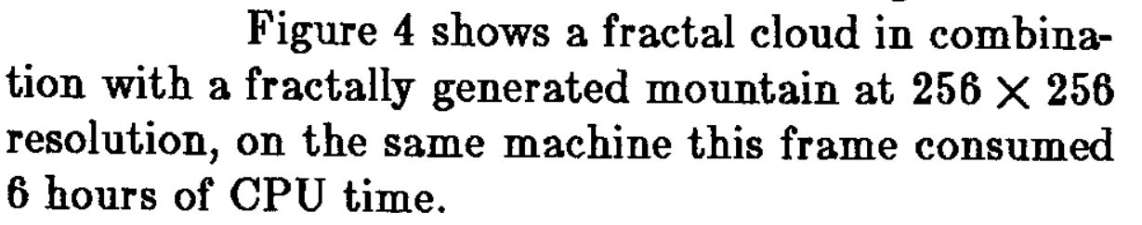
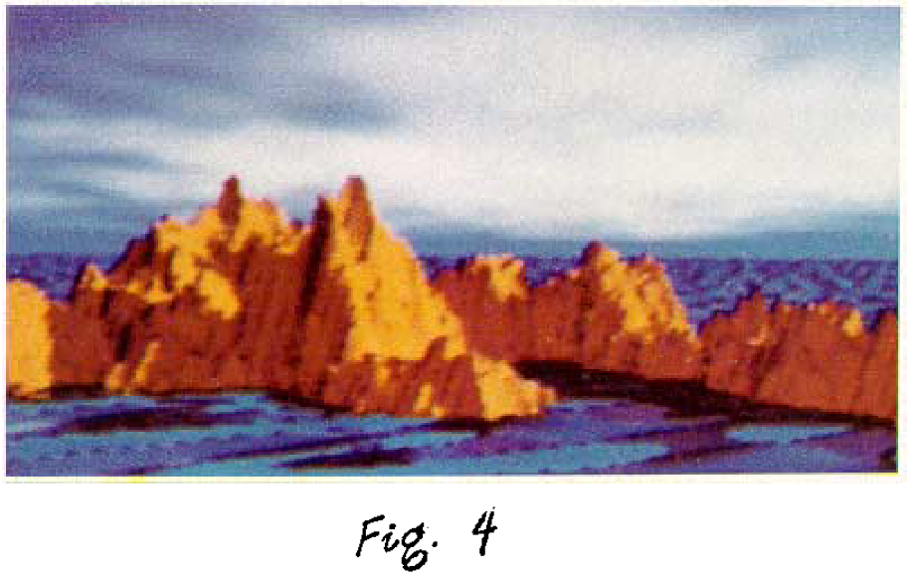
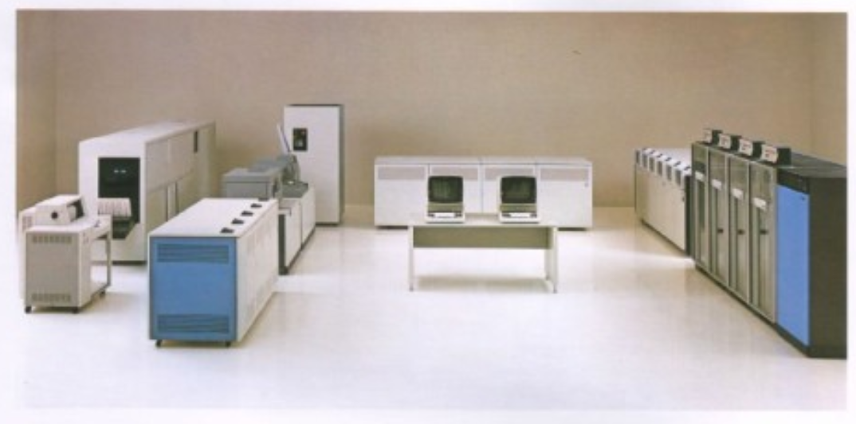
Throwback slide
(cca [3,6] MHz) + 4MB storage
booklet

Slide 11
NeRF rendering
1) march camera rays through the scene to generate a sampled set of 3D points
2) use those points and their corresponding 2D viewing directions as input to the neural network to produce an output set of colors and densities
3) use classical volume rendering techniques to accumulate those colors and densities into a 2D image
1.5 days on a single nvidia V100 using adam with N_{c}=64 N_{f}=128
Because this process is naturally differentiable, we can use gradient descent to optimize this model by minimizing the error between each observed image and the corresponding views rendered from our representation

Slide 12
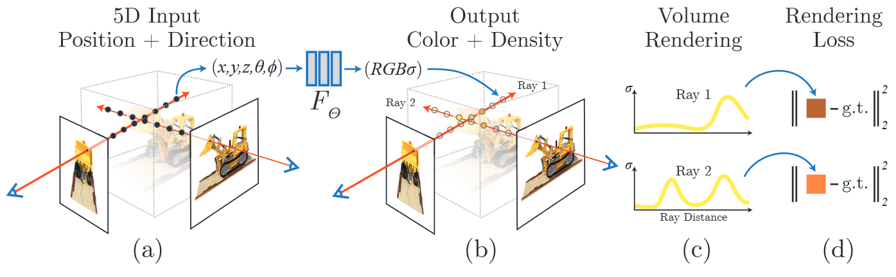
NeRF rendering
Mildenhall, Srinivasan, Tancik et al. - ECCV20

Slide 13
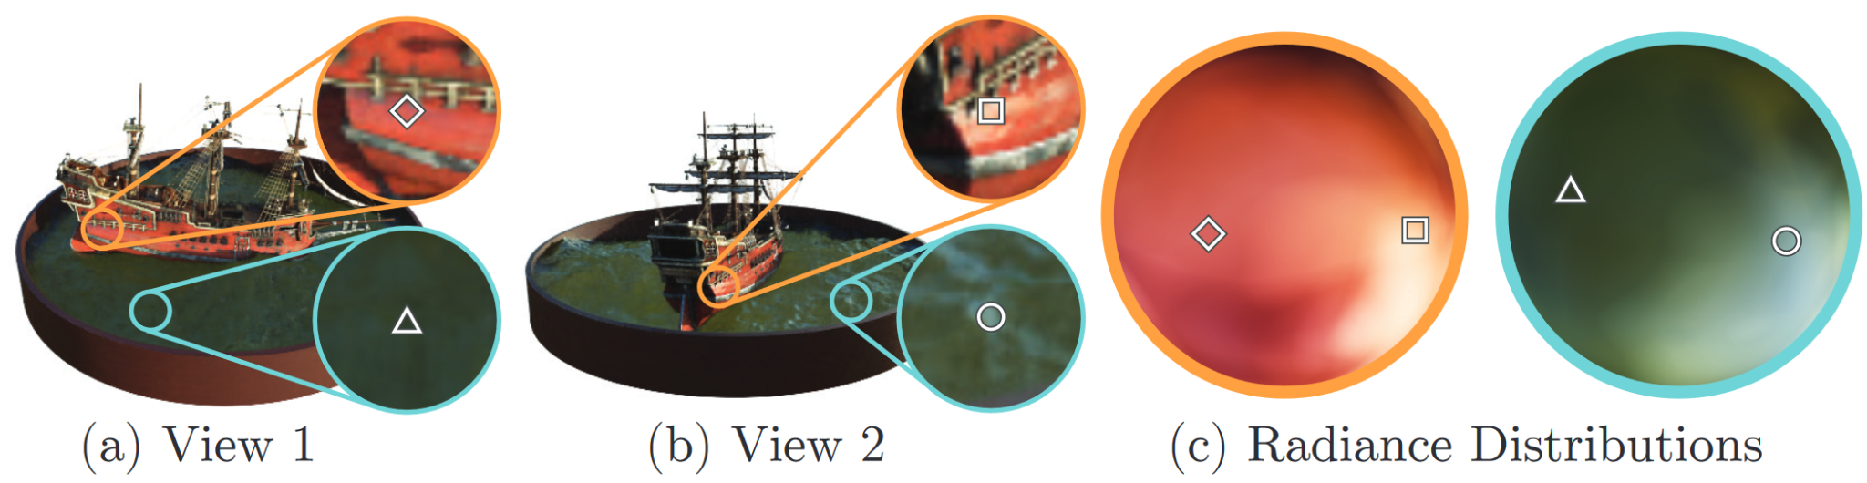
What does this d in (x,d) actually mean?
Non Lambertian (Lambertian = matte) effects are handled by the viewing direction
This is a significant contribution when compared to previous work
Mildenhall, Srinivasan, Tancik et al. - ECCV20

Slide 14
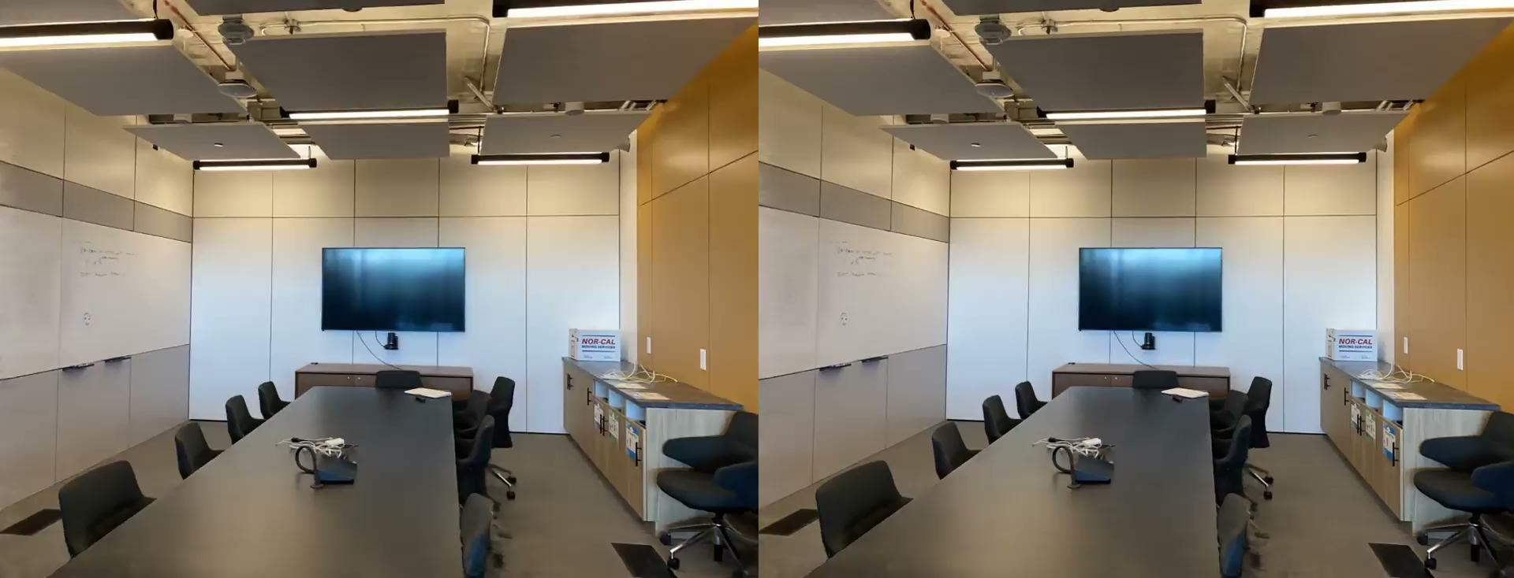

Slide 15
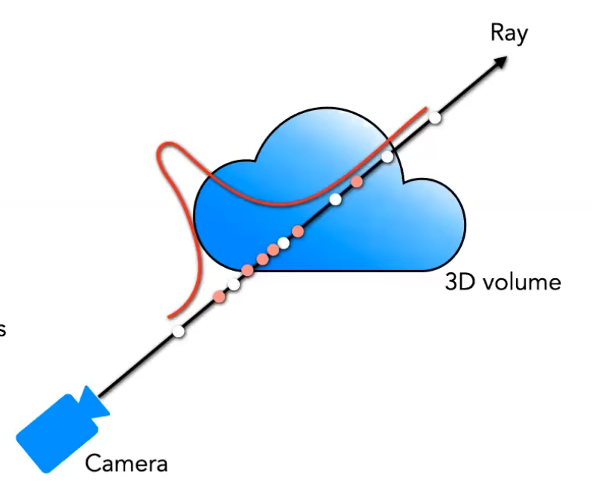
5.2 Hierarchical volume sampling
Two pass rendering
Levoy - ACM_TOG90

Slide 16
Use cases of non-vanilla NeRFs
Depth estimation

Slide 17
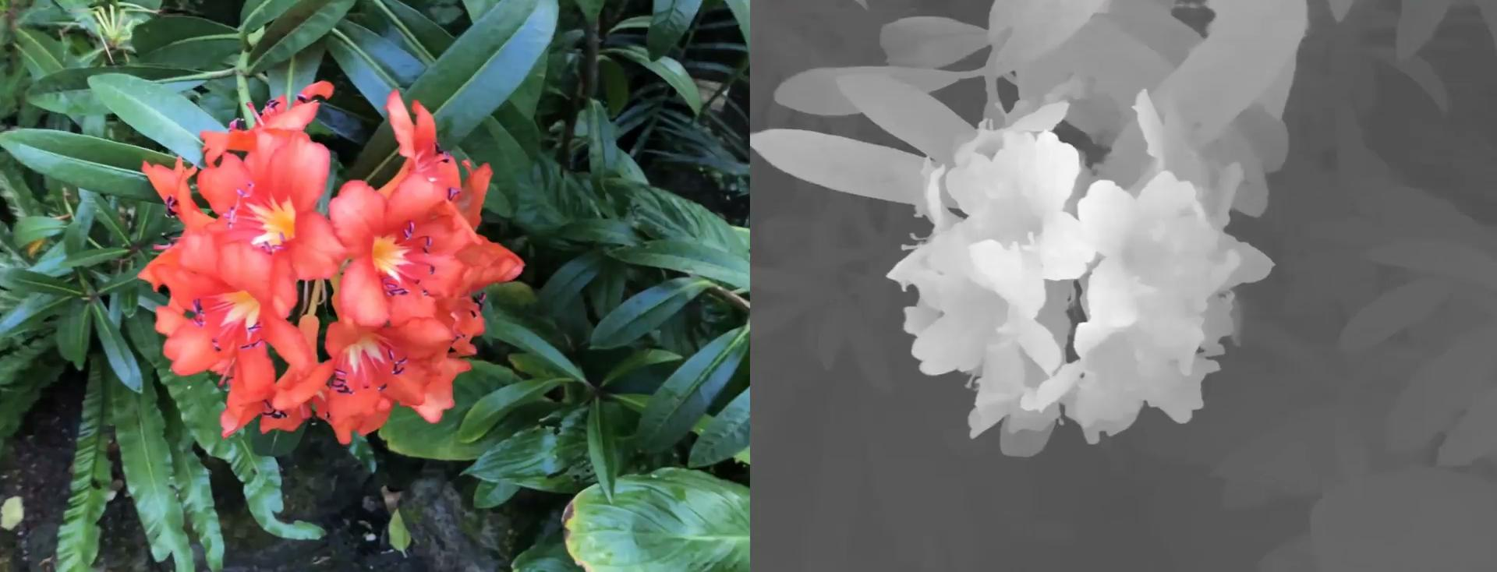

Slide 18
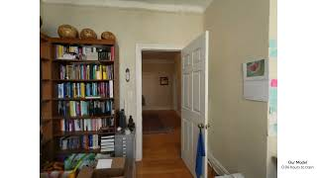
Mip-nerf360 - Barron 23, arxiv
Zip-NeRF - Barron 23, arxiv jax

Slide 19
Dreamfusion
Poole et al - arxiv22

Slide 20


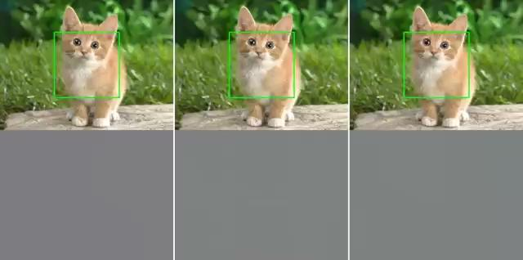
BARF : Bundle-Adjusting Neural Radiance Fields,
positional encoding behaves strangely
with imperfect camera poses
w/o positional encoding w/ full positional encoding BARF (theirs)
Lin et al. - ICCV21
Park et al. - ICCV21

Slide 21
Faster training
https://nvlabs.github.io/instant-ngp/ -12k zvjezdica
https://developer.nvidia.com/blog/time-magazine-names-nvidia-instant-nerf-a-best-invention-of-2022/
Best paper siggraph22
https://docs.nerf.studio/en/latest/

Slide 22
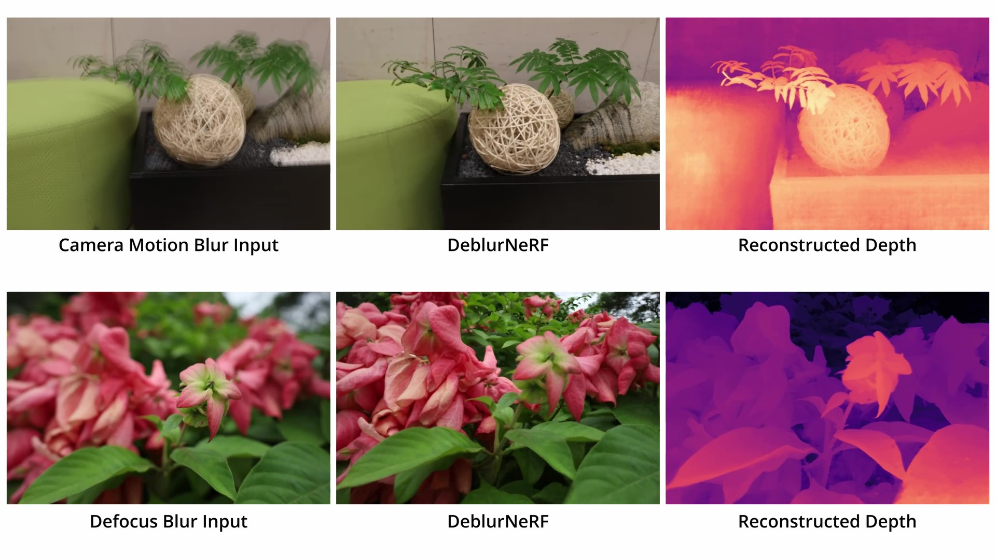
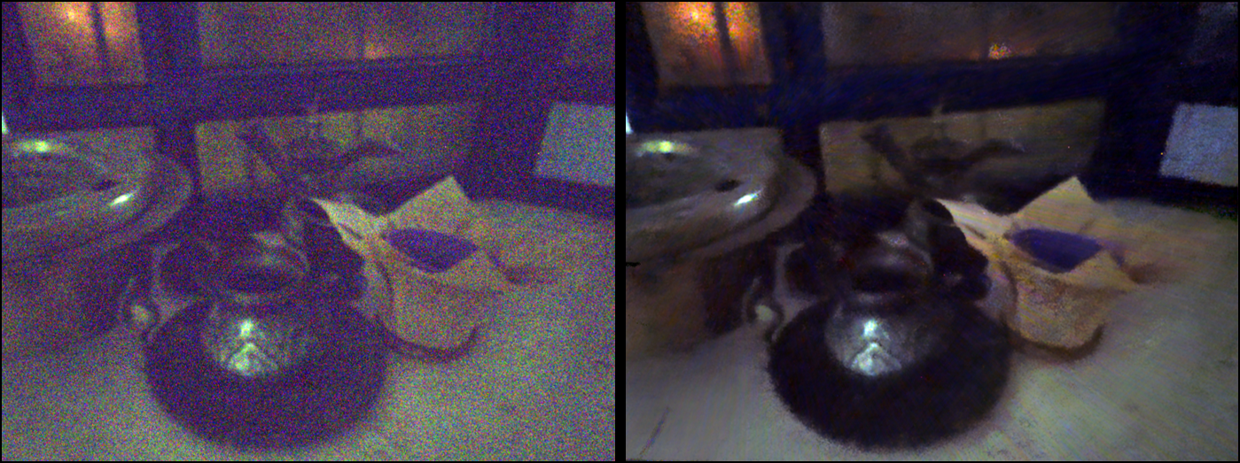
Denoising
Burst denoising - images taken in low-light environments
Motion blur
Pearl et al - CVPR22
Ma et al - CVPR22

Slide 23
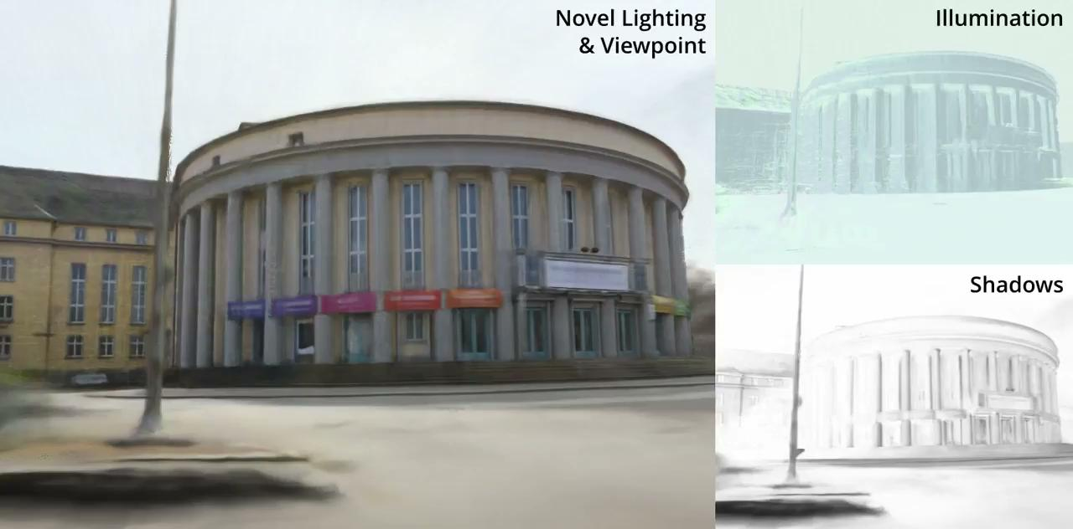
Scene relighting
Rundev et al. - ECCV22

Slide 24
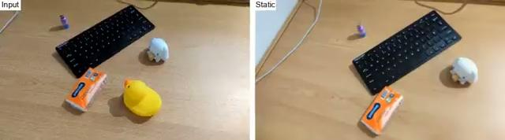
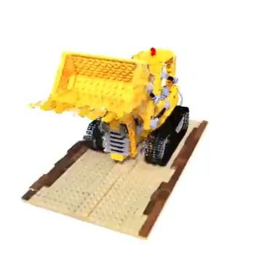
Few-shot NeRFovi
D2nerf
SinNeRF
Wu, NIPS22
Xu, Yiang - ECCV22

Slide 25
0 23 papers btw

Slide 26
Segment Anything in 3D with NeRFs
Cen et al. - preprint

Slide 27
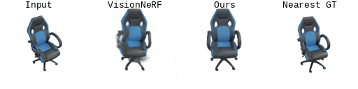
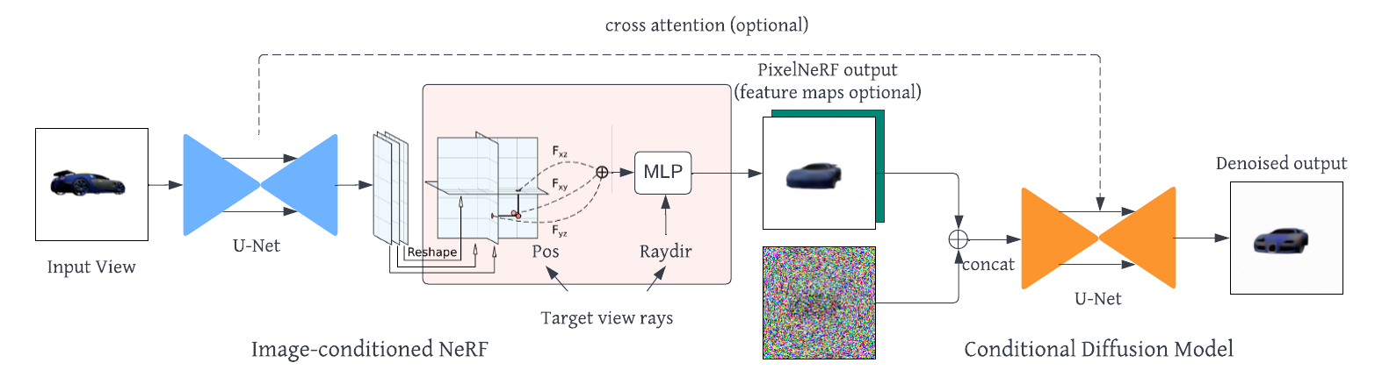
Nerfdiff
Gu et al. - arxiv23

Slide 28
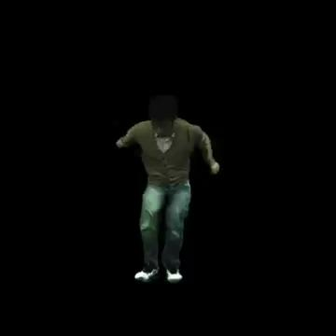
Monohuman
Yu et al. - CVPR23

Slide 29
But Jere, I wanna learn more about NeRFs
https://youtu.be/HfJpQCBTqZs - one of the original authors holding a seminar at MIT
https://youtu.be/CRlN-cYFxTk - Yannic
https://youtu.be/Al6NTbgka1o - FFN Cambridge seminar
https://github.com/MatrixBrain/awesome-NeRF
Neural Radiance Fields: Past, Present, and Future, Ansh Mittal
https://jere357.github.io/assets/preza.pptx
Unironically - twitter

